Slide 1
Lab 1 Helper
Ioana Ciuciu,
ioana.ciuciu@ubbcluj.ro

Slide 2
Info about the lab ☺
Lab requirements available here:
www.cs.ubbcluj.ro/~sabina
2 weeks delay = 1 point penalty
Max 2 lab assignments / lab
Final lab grade: ((GradeLab1-PenaltyLab1) + (GradeLab2-PenaltyLab2) + (GradeLab3-PenaltyLab3))/3
No lab delivery during weeks 13, 14 and during the exams (sesiune)
During retake session (restante): max 2 labs, with a penalty of 35%, only if the practical exam is retaken (except when the student has 10 p. for the practical exam)
Attendance: 6 labs out of 7 ( https://www.cs.ubbcluj.ro/wp-content/uploads/Hotarare-CDI-29.04.2020.pdf)
Practical exam: weeks 13, 14 (in order to promote, a grade >= 5 is needed)

Slide 3
Prerequisites
Visual Studio – installed
For Linux users
Virtual machine, or
Mono Project (https://www.mono-project.com/)
Open source implementation of Microsoft's .NET Framework
! For the practical exam, an app using Windows Forms will be required!
Teams access code: cco1a4l

Slide 4
Part 1 - ADO.NET

Slide 5
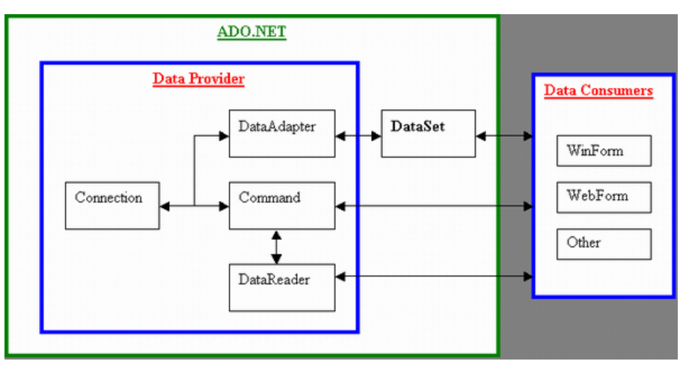
The ADO.NET Object Model
ADO.NET
Bridging between the front end controls and the back end DB
2 central components of ADO.NET classes
The .NET Framework Data Provider
The DataSet
Notes:
ADO.NET provides a bridge between the front end controls and the back end database.
The ADO.NET objects encapsulate all the data access operations and the controls interact with these objects to display data, thus hiding the details of movement of data.

Slide 6
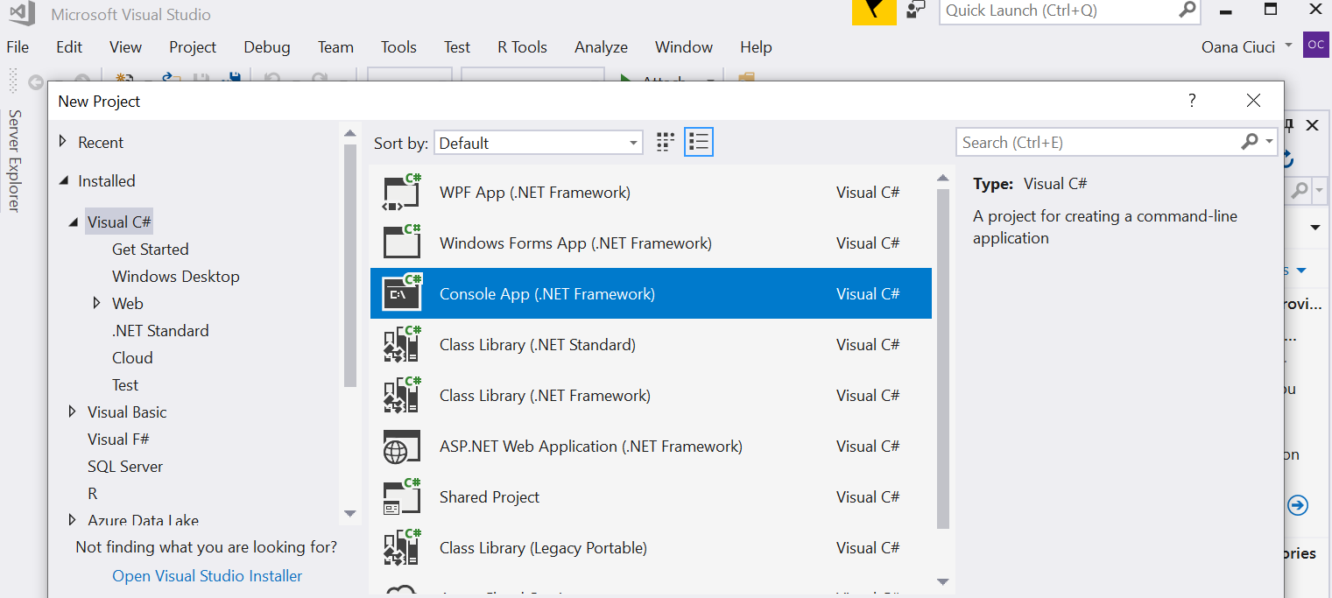
Part 1 – create a console app

Slide 7
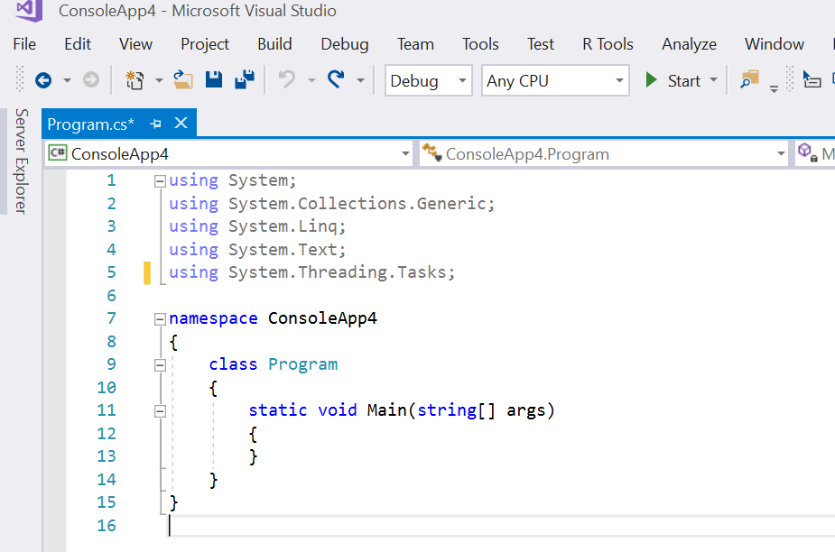
Part 1 – create a console app

Slide 8
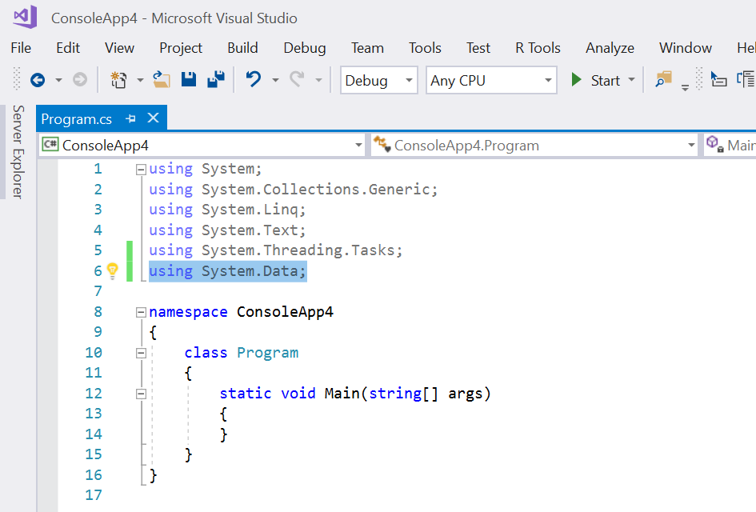
Part 1 – create a console app
Packages needed
System.Data

Slide 9
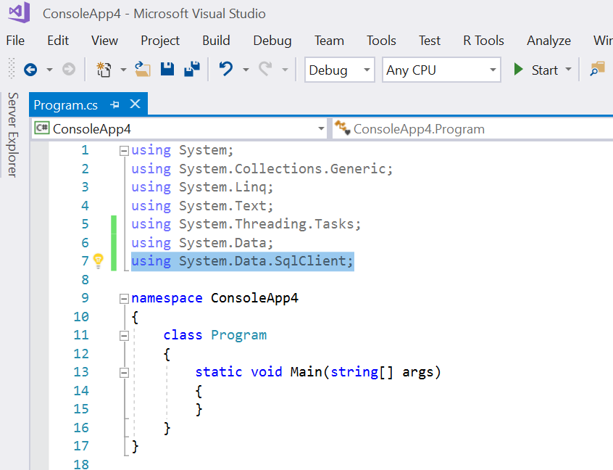
Connection to an ADO.NET Database
Before working with a database, you have to add the SqlClient .NET Data Provider namespace

Slide 10

Connection to an ADO.NET Database
Declare the connection string pointing to your database (SQL Server DB):
Data Source – the DB server name (check on your computer)
Initial Catalog – the DB name
Integrated Security: true/false depending on the security level you choose for the DB server

Slide 11
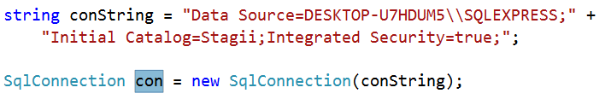
Connection to an ADO.NET Database The SqlConnection Object
Create an SqlConnection object via which you connect to the DB
Then, pass the connection string to the SqlConnection object

Slide 12
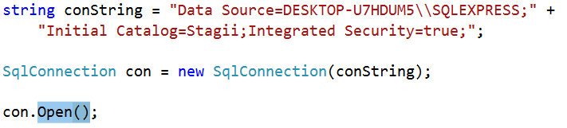
Connection to an ADO.NET Database
Open the connection
Recommendation:
Open a connection when you need it, and
Close it as soon as you have finished with it

Slide 13
The SqlCommand Object
You use a command object to send SQL statements to the database
The connection object is used by command objects so they will know which database to execute the command on
A command object can be used
Alone, to execute a command directly, OR
Assign a reference to the command object to a SqlDataAdapter, which holds a set of commands that work on a group of data as described further (during lab & seminar)

Slide 14
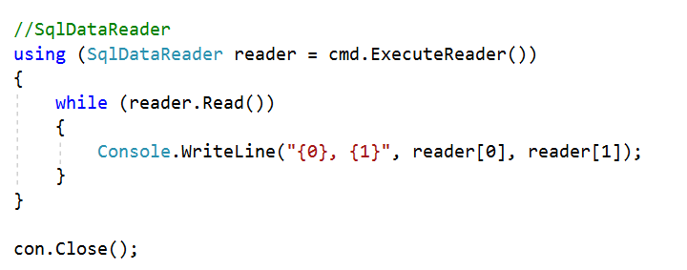
The SqlDataReader Object
The data reader object allows you to obtain the results of a SELECT statement from a command object
The data returned from a data reader is a fast forward-only stream of data (you can only pull the data from a stream in a sequential manner)
If data manipulation is needed then a better alternative is a DataSet object (see further)

Slide 15
The DataSet Object
DataSet objects are in-memory representations of data
DataSet objects contain multiple DataTable objects
Contain columns and rows, just like normal database tables
You can even define relations between tables to create parent-child relationships
DataSet is an object that is used by all of the Data Providers (does not have a Data Provider specific prefix)

Slide 16
The DataAdapter Object
The data adapter object
Fills a DataSet object when reading the data and
Writes in a single batch when persisting changes back to the database
A data adapter
Contains a reference to the connection object
It opens and closes the connection automatically when reading from or writing to the database
The data adapter contains command object references for SELECT, INSERT, UPDATE, and DELETE operations on the data
You will have a data adapter defined for each table in a DataSet and it will take care of all communication with the database for you
All you need to do is ‘tell’ the data adapter when to load from or write to the database

Slide 17
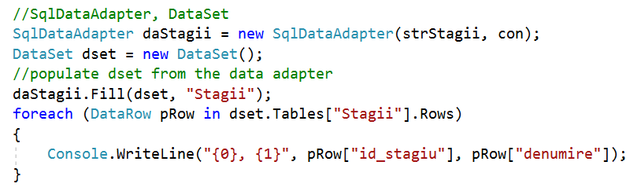
DataSet and DataAdapter Objects

Slide 18
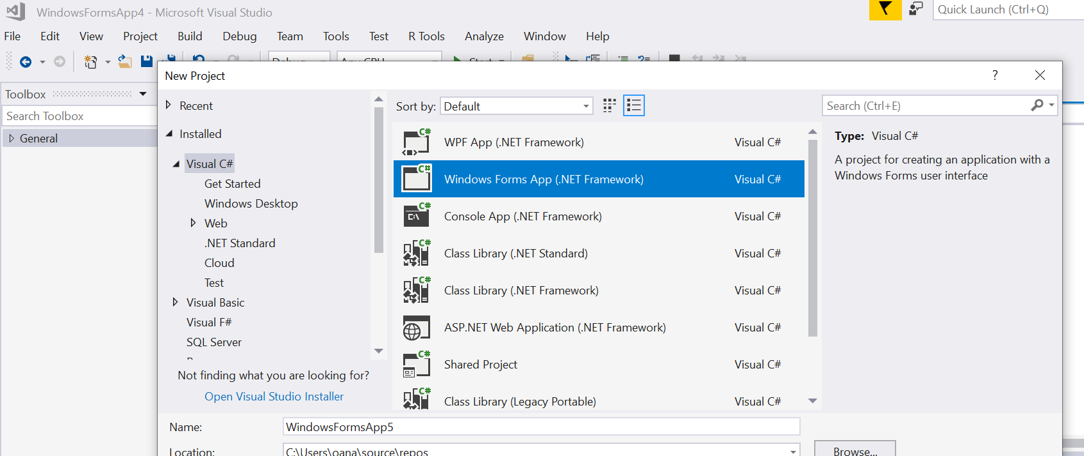
Part 2 – create a WindowsForms app (Work in progress version)

Slide 19
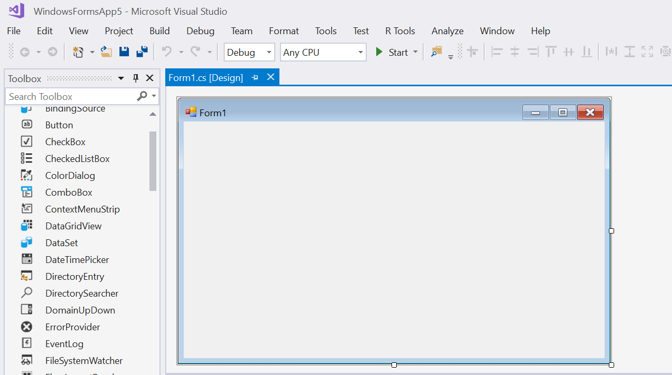
Part 2 – create a WindowsForms app

Slide 20
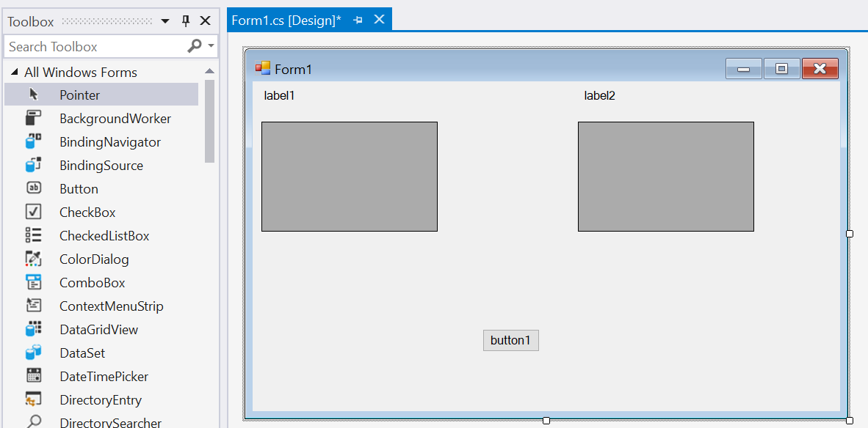
Part 2 – create a WindowsForms app
Populate the form from the Toolbox: 2 Label controls, 2 DataGridView controls, one Button

Slide 21
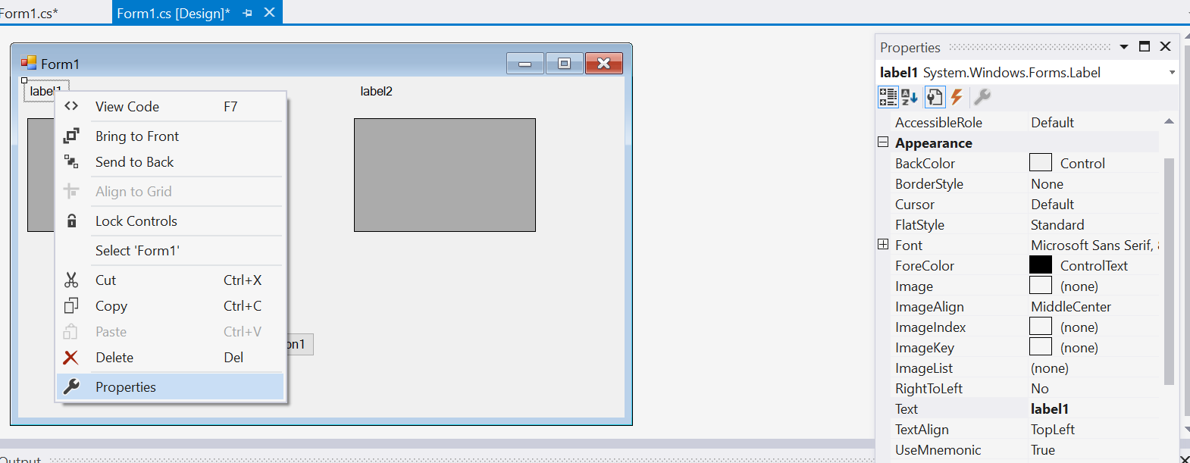
Part 2 – create a WindowsForms app
Customize your controls/GUI (Properties)

Slide 22
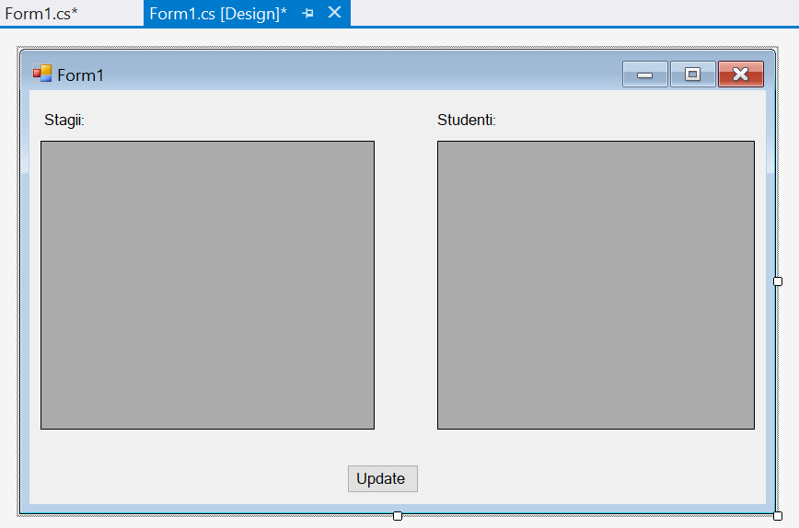
Part 2 – create a WindowsForms app

Slide 23
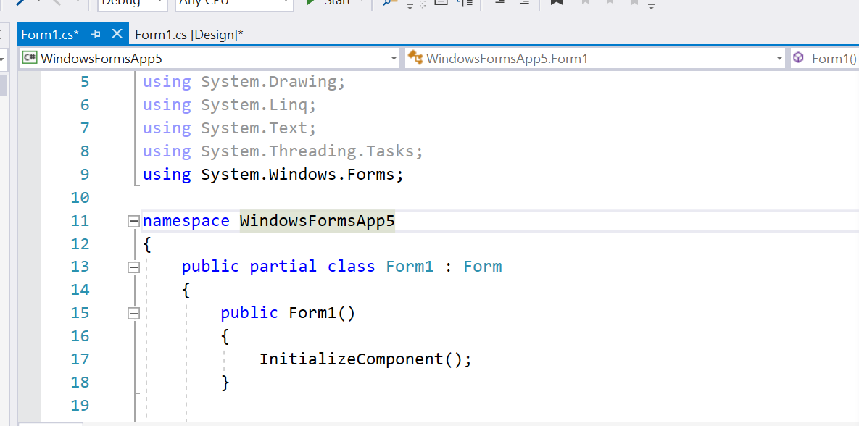
Part 2 – create a WindowsForms app
From the Designer, go to code (F7)

Slide 24
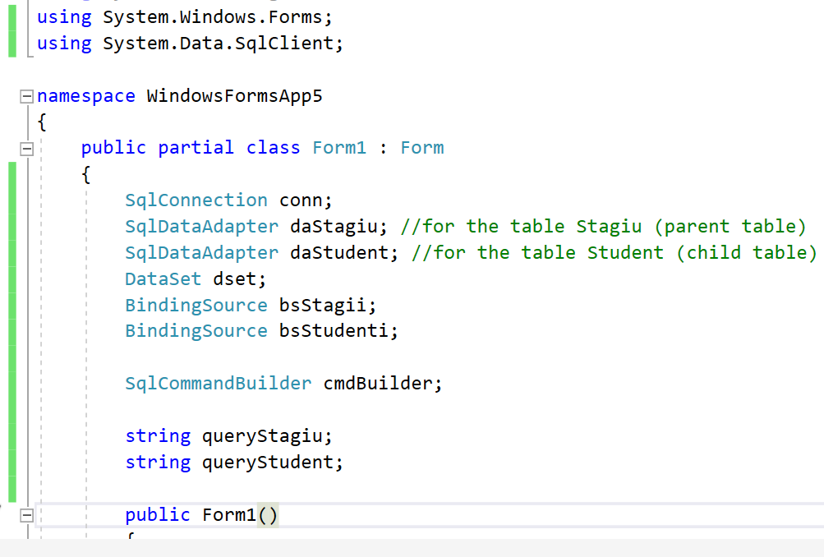
Part 2 – create a WindowsForms app

Slide 25
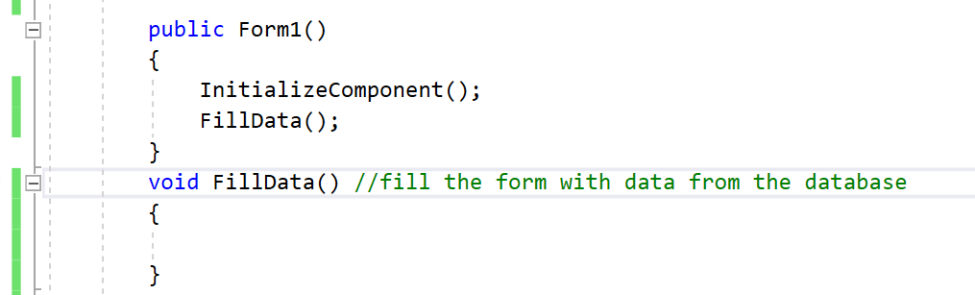
Part 2 – create a WindowsForms app
Implement method FillData()
call it from the constructor !

Slide 26
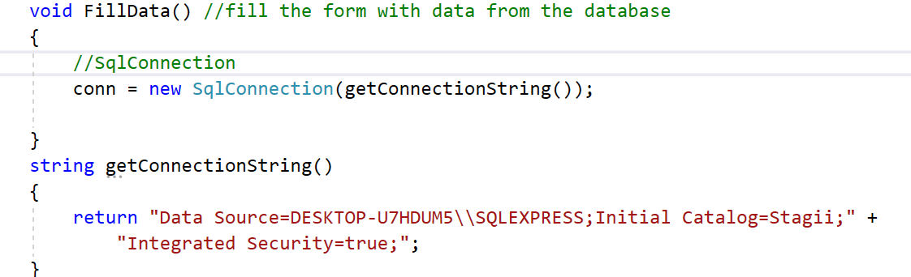
Part 2 – create a WindowsForms app
Implement method FillData()

Slide 27
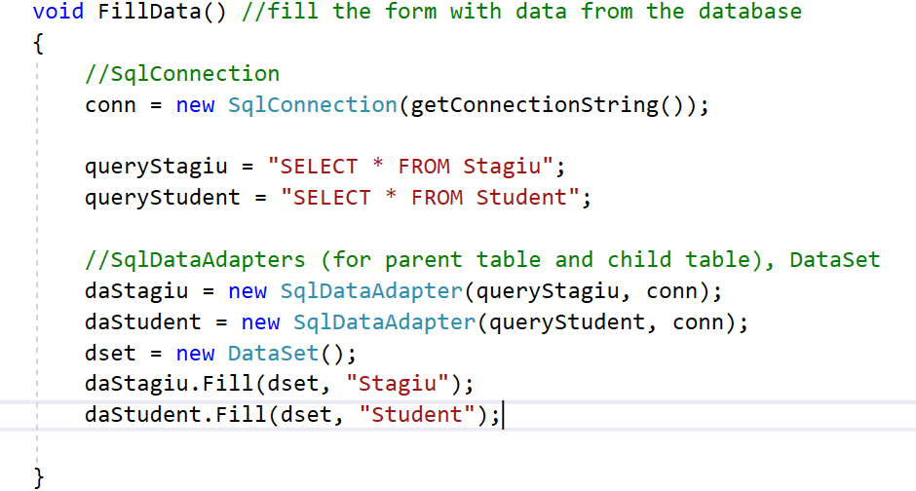
Part 2 – create a WindowsForms app
Implement method FillData()

Slide 28
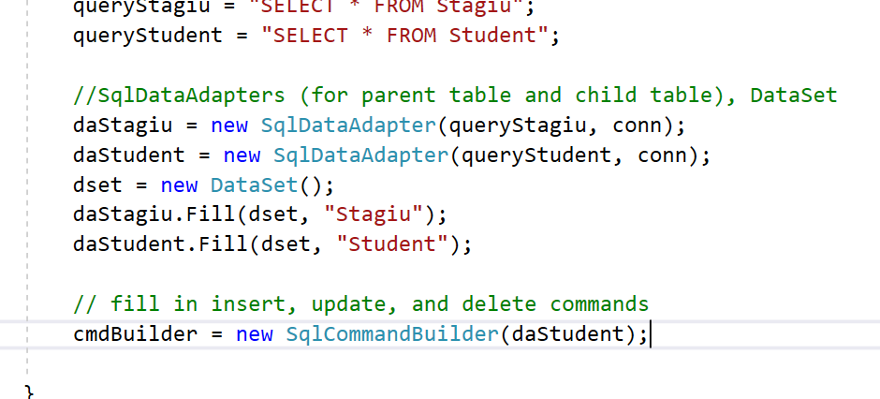
Part 2 – create a WindowsForms app
Implement method FillData()

Slide 29
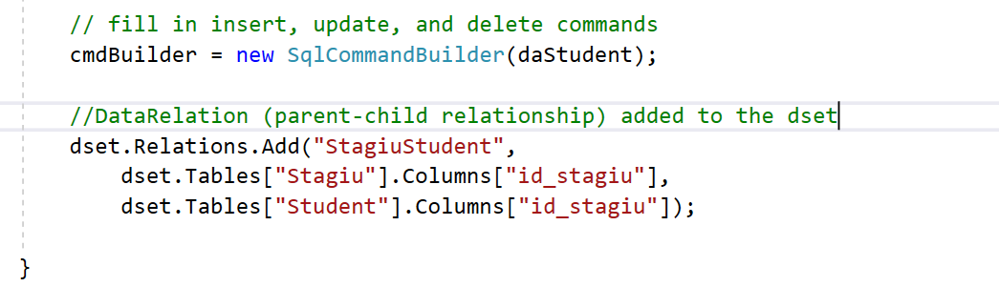
Part 2 – create a WindowsForms app
Implement method FillData()

Slide 30
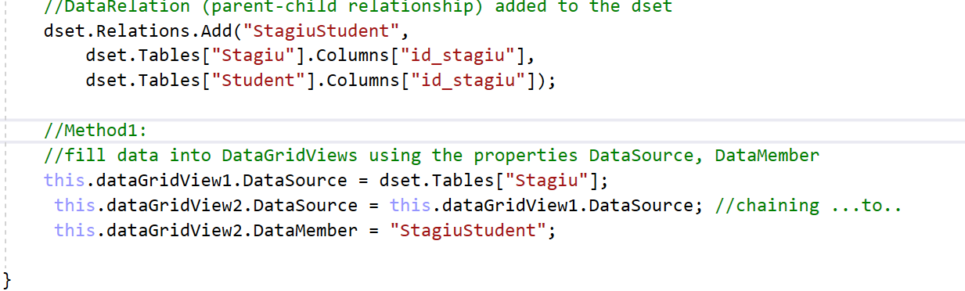
Part 2 – create a WindowsForms app
Implement method FillData()

Slide 31
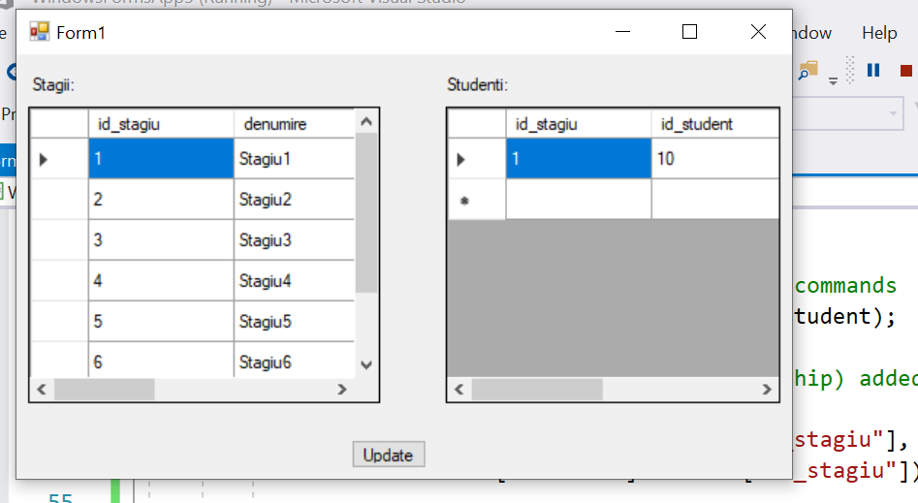
Part 2 – create a WindowsForms app
Implement method FillData()

Slide 32
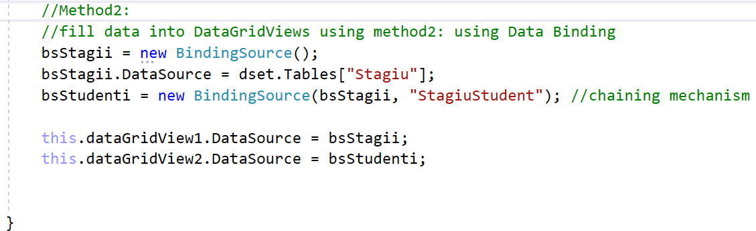
Part 2 – create a WindowsForms app
Implement method FillData()

Slide 33
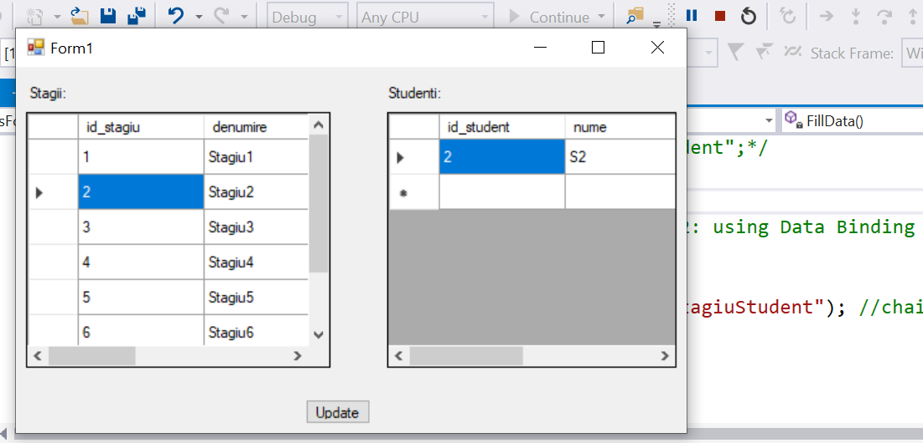
Part 2 – create a WindowsForms app

Slide 34
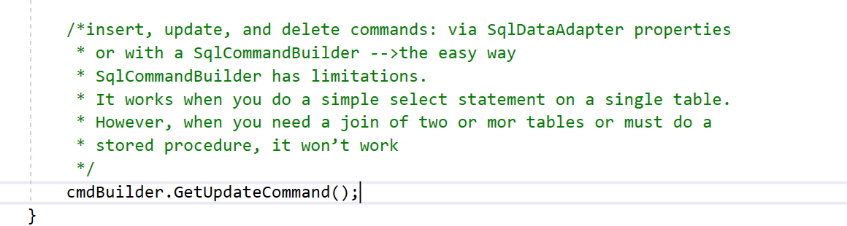
Part 2 – create a WindowsForms app
Implement method FillData()

Slide 35
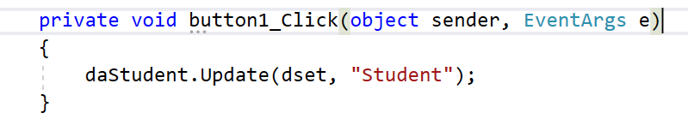
Part 2 – create a WindowsForms app
Implement “Update” button action

Slide 36
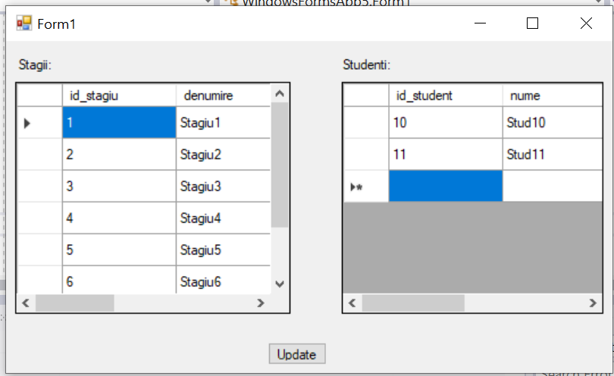
Part 2 – create a WindowsForms app
Check how “Update” button is working (for Insert, Update, Delete)

Slide 37
References
http://csharp-station.com/Tutorial/AdoDotNet/Lesson01
http://www.codeproject.com/Articles/8477/Using-ADO-NET-for-beginners
http://www.codeproject.com/Articles/24656/A-Detailed-Data-Binding-Tutorial

